Slide 1
C/C++ Extension Module for Python
Code, build, install, import
Gene Olafsen

Slide 2
Demo Support
Command Prompt
Cd \Users\Gene\source\repos\MetrowestDeveloperModule\MetrowestDeveloperModule
"c:\users\gene\anaconda3\python" setup.py build
"c:\users\gene\anaconda3\python" setup.py install
Python Prompt
print(MetrowestDeveloperModule.__author__)
print(MetrowestDeveloperModule.example("test",1))

Slide 3
Overview
This presentation will review the steps necessary to:
Create a C/C++ extension module.
Build the code and link it to the necessary Python extension module libraries.
Create a Python setup script for the extension module.
Install the extension module into the Python environment.
Import the extension module into the Python environment.
Call functions/properties on the module.

Slide 4
Benefits
Python extensions written in C++ (or C) are commonly used to:
Extend the capabilities of a Python interpreter
Enable access to operating system functions
Wrap existing native libraries providing a Python-friendly interface

Slide 5
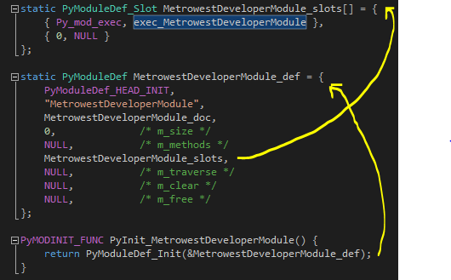
Native Code Template
Multi-phase Initialization

Slide 6
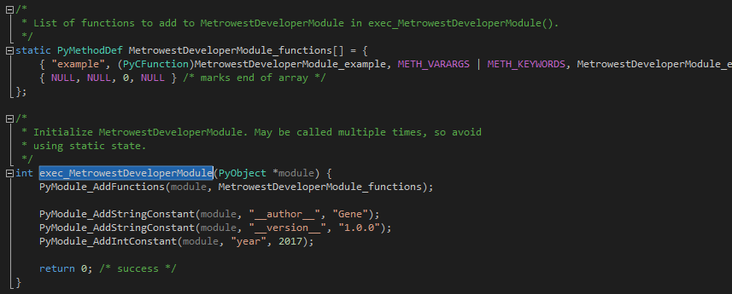
Initialize Functions and Properties
PyMethodDef

Slide 7
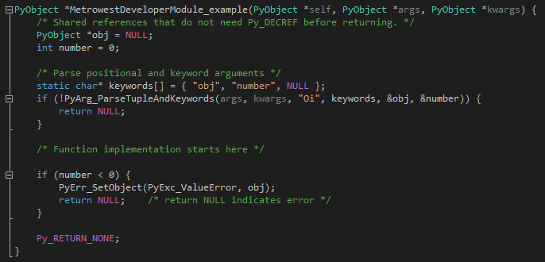
Sample function
Reference Counting

Slide 8
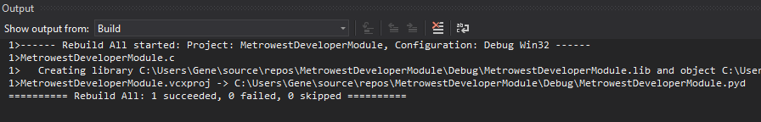
Compile
Make sure that the Python headers are in the include path.
A 'strict' setting may be used to ensure that only Linux compatible headers, libraries, etc. are utilized.
Compiling within Visual Studio is only a syntax validation step.

Slide 9
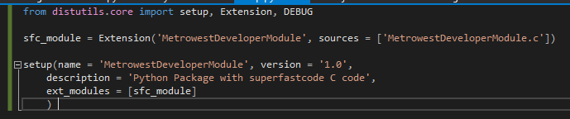
Setup.py
Python code setup file

Slide 10
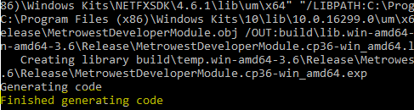
Build
Extension modules can be built using distutils, which is included in Python. Since distutils also supports creation of binary packages, users don’t necessarily need a compiler and distutils to install the extension.
"c:\users\gene\anaconda3\python" setup.py build

Slide 11
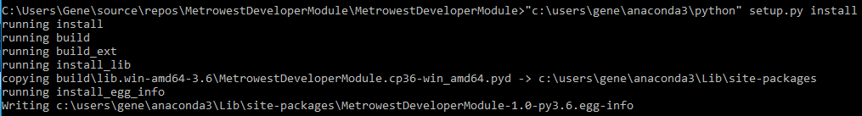
Install
"c:\users\gene\anaconda3\python" setup.py install

Slide 12
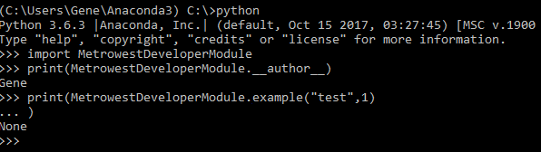
using
Start a Python instance

